Slide 1


W-tiny LFU
C++ version

Slide 2
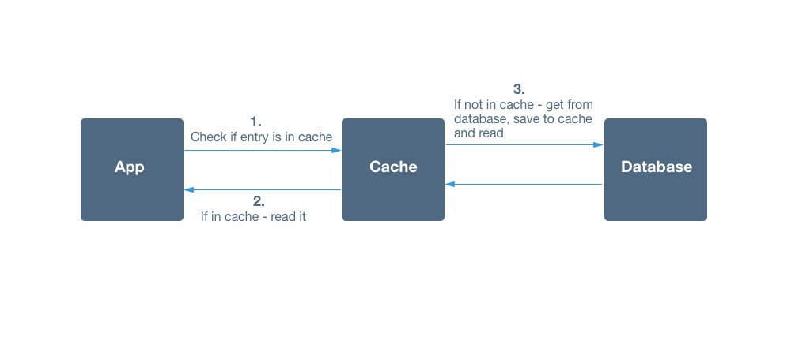
caching
Caching is the process of storing copies of files in a cache, or temporary storage location, so that they can be accessed more quickly. Technically, a cache is any temporary storage location for copies of files or data, but the term is often used in reference to Internet technologies.
In other words it’s a shortcut to the data we need the most

Slide 3



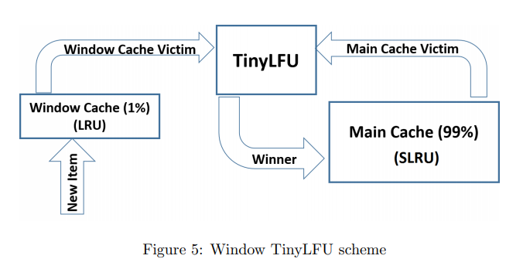

Window-tinyLFU
Is a frequency-based cache admission policy in order to boost the effectiveness of caches subject to skewed access distributions.
the cache consists of two areas:
Window cache is a simple LRU
Main Cache which is SLRU cache With an admission policy.
instead of maintaining a ghost entries we use approximate counting scheme to maintain statistics of items frequency with periodic aging.
Items evicted from the Window Cache are candidates to enter the Main Cache.
Default Window Cache is 1% of the cache.
- This algorithm was adapted by multiple open source library and products like Caffeine, Cassandra , neo4j etc. ..

Slide 4
C++ implementation of WtinyLFU Currently setting under my GitHub repository : mahmodyaseen/WTLFU-cPlusPlus
WTLFU++:
We divided the implementation into two parts:
Main Cache – which consists of two parts, TinyLFU and frequency sketch w/doorkeeper
Window Cache – we implemented the two versions, adaptive hill climbing and the default percent window.
We used multiple classes to help managing the data, help get the results and traces.
Simulator
Window Policy: Adaptive/ sketch
Sketch Type / adaptive algorithm
Admit / Evict victim
Update the states

Slide 5
W-tinyLFU++
Simulator
hillClimberWindow
WindowTinyLFU
TinyLFU
TinyLFU
TinyCachePolicy
hillClimberWindow Policy
Gradient
hill
TinyLFU
Count-min-4
Climber
Periodic
countmin64
perfecTable
TinyTable
Incremental
RandomTable
IndicatorReset

Slide 7
C++ implementation of WtinyLFU Main Cache implementation, Main Cache I shared on both versions, adaptive and non-adaptive.
Main Cache is divided into two parts, classes and general explanation:
TinyLFU – a main class to help handle the needed sketch, admit, record victims and candidates.
Main Sketch (admission) – we implemented multiple frequency-based sketch:
Count-min-4 - A probabilistic multiset for estimating the popularity of an element within a time window, and extensions provide the aging process.*
Count-min-64 - A version of the TinyLFU sketch based on a regular conservative update sketch. The difference is that a counter may not exceed a maximum and any time the sum of events reach a predefined values we divide all counters by 2 in what is called a reset operation.
perfect Table - A the perfect frequency with aging performed using a periodic reset.
Random table - A probabilistic multiset for estimating the popularity of an element within a time window. The maximum frequency of an element. The size of the sample in relation to the cache size can be controlled with a sample factor. Instead of halving the popularity of elements a random element is dropped when table is full.
Tiny table

Slide 8
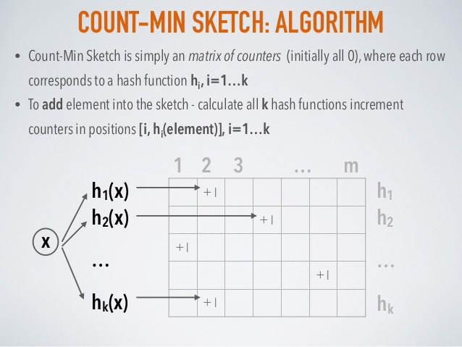
Aging process:- our count min sketch :- A probabilistic multiset for estimating the popularity of an element within a time window. We added multiple classes to provide the aging process: 1. PeriodicResetCountMin4:- A sketch where the aging process is a periodic reset. 2. IndicatorReset:- A sketch where the aging process is a dynamic process and adjusts to the recency/frequency bias of the actual workload recognized by the indicator. 3. Incremental:- A sketch where the aging process is an incremental reset. 4. ClimberReset :- A sketch where the aging process is a dynamic process and adjusts to the recency/frequency bias of the actual workload.

Slide 9
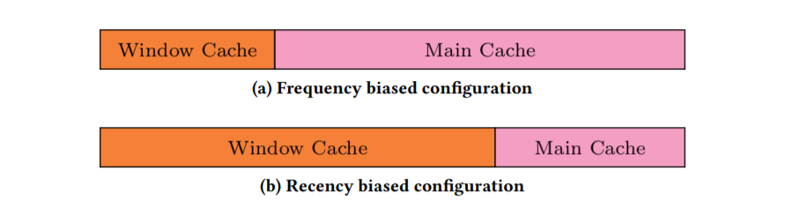
Adaptive Window version
Using the adaptive hill climbing algorithm we explore dynamically adjusting the relative size of the window (or Temporal) cache between 0−100% of the total cache size in order to be able to handle different work loads accordingly.
In our implementation we provided multiple adaptive algorithms:-
Gradient based
Adam - Adaptive Moment Estimation (Adam) optimizer. Adam is an improvement on stochastic gradient descent with momentum, that incorporates adaptive learning rates.
AmsGrad- AMSGrad is an improvement on Adam that ensures that the velocity is always increasing, correcting for cases where Adam fails to converge to the optimal solution.
Nadam- Nesterov-accelerated Adaptive Moment Estimation (Nadam) optimizer. Nadam modifies the Adam optimizer to replace normal momentum with Nesterov's accelerated gradient.
Stochastic - Stochastic gradient descent (SGD) optimizer.
Simple hill climber - A naive, simple hill climber.

Slide 10
C++ implementation of WtinyLFU Vs Caffiene comparison the results of caffeine Java implementation if W-tinyLFU with the results of my C++ implementation of W-tinyLFU.
policy
Caffiene
WtinyLFU++
Aging:
Sketch.WindowTinyLFU.Periodec
Periodec.Incremental
Periodec.climber
Default 1% policies:
count-min-64
random-table
perfect-table
Tiny-table
HitRate Time/ms
55.74% 322.9ms
55.54% 251ms
55.8% 245.6ms
--------------------------
56.25% 658.4ms
55.9% 351.1ms
56.29% 270ms
55.59% 208.4ms
HitRate Time/ms
55.76% 96ms
55.02% 113ms
54.17% 102ms
----------------------------
56.28% 127ms
55.7% 363ms
56.00% 123ms
55.42% 267ms

Slide 11
C++ implementation of WtinyLFU Vs Caffiene comparison the results of caffeine Java implementation if W-tinyLFU with the results of my C++ implementation of W-tinyLFU.
Policy HillClimberWindowTinyLfu
Caffiene
WtinyLFU++
Adaptive [1-5%]
Adam
Nadam
simple-climber
Stochastic
ams-grad
HitRate Time/ms
54.47% 171.6ms
54.58% 105.8ms
54.83% 110.1ms
55.49% 91.1ms
54.41% 124ms
HitRate Time/ms
55.73% 102ms
55.7% 99ms
55.67% 99ms
55.78% 100ms
55.42% 102ms

